Slide 1
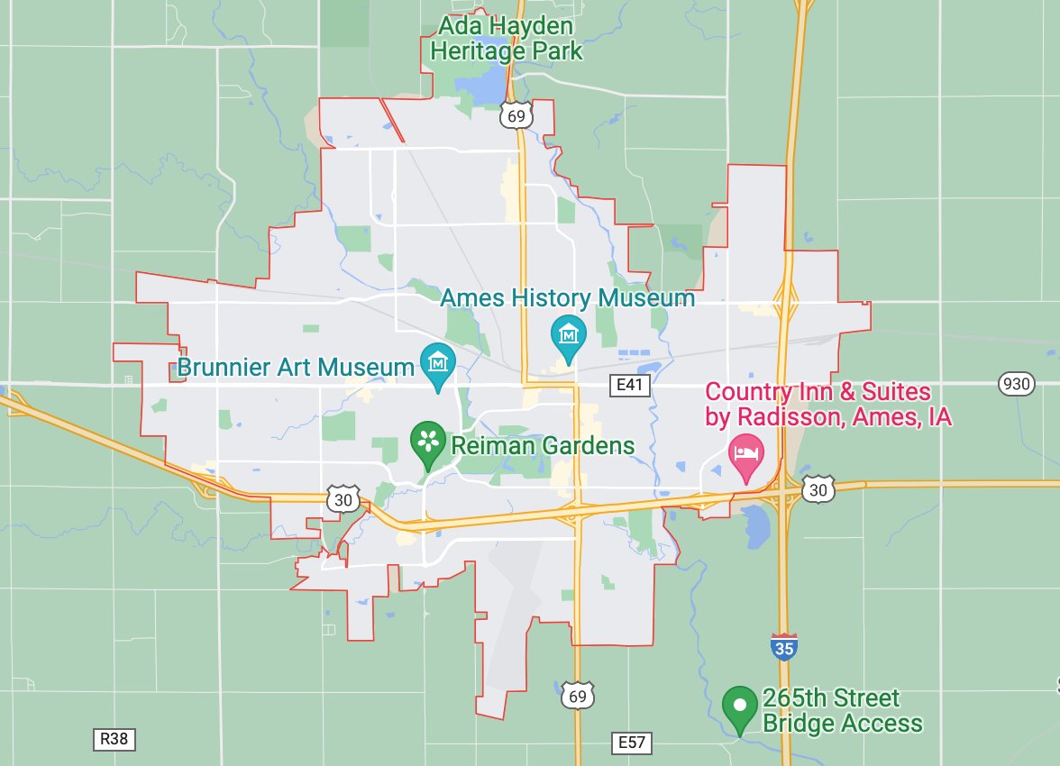
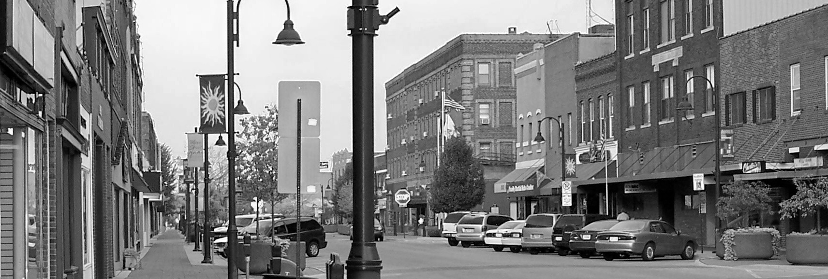
PROJECT 2
Getting Ahead of the Market: Modeling Ames Estate Sale Price based on Different House Features Available.

Slide 2
Overview
Problem Statement
As data scientists engaged by Propnex, we are tasked to develop an accurate model to predict housing price in Ames, Iowa. In this study, we will attempt to use machine-learning model to forecast the house price in Ames, Lowas based on the given fixed house characteristics
Notes:
Good morning everyone, today we have Joel, jia sheng and me ivan presenting to you on Project 2.
The problem statement that we have for project 2 is simply we are engaged by propnex and we are tasked to develop accurate model to predict housing price based on the given fixed house characteristics by using machine-learning model

Slide 3
Content
Methodology
Exploratory Data Analysis (EDA)
Base Model
Feature Engineering
Choosing our Final Model
Conclusion
Recommendation

Slide 4
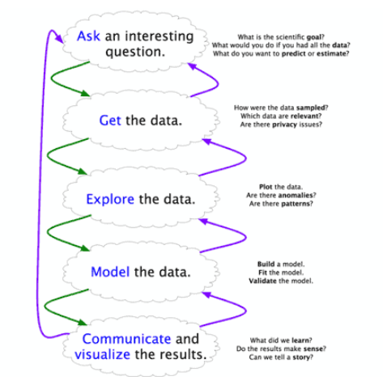
METHODOLOGY
Blitzstein & Pfister’s Workflow
Step 1: Ask an interesting question
Step 2: Get the data
Step 3: Explore the data
Step 4: Model the data
Step 5: Communicate and visualize the results
Notes:
Step 1: Is to define a clear and concise problem statement which we have covered earlier
Step 2: Get the data
Step 3: Explore the data
Perform exploratory data analysis to determine any meaningful correlations
Dealing with outliers
Perform feature engineering
Step 4: Model the data
Create a base model with Linear Regression for benchmark
Optimize model performance
Selecting the best Machine learning algorithm/model selection for submission
Data Visualization
subplots
histograms
scatterplots
boxplots
Step 5: Communicate and visualize the results

Slide 5

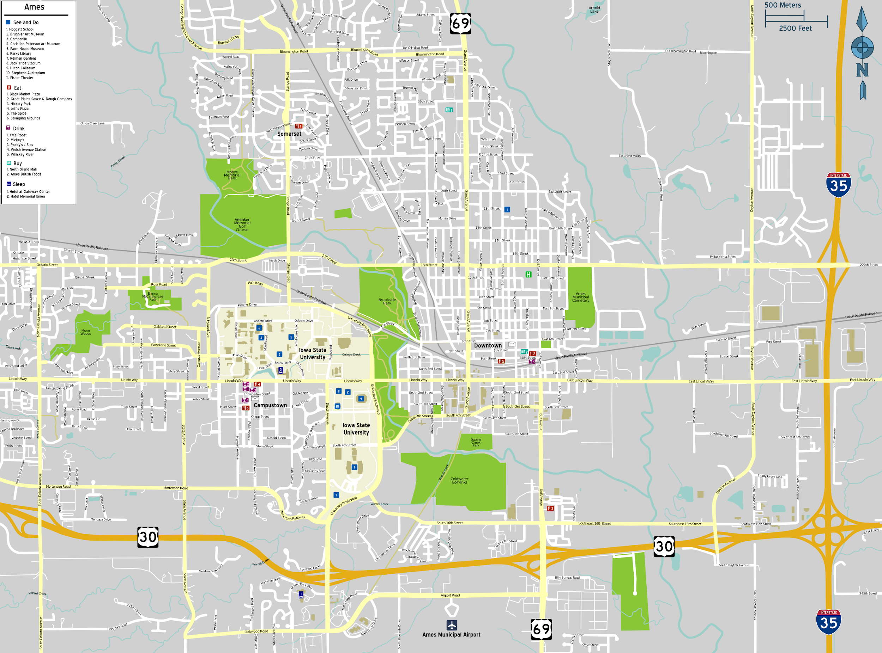
EXPLORATORY DATA ANALYSIS
Dataset Overview
Dealing with Null Values
Data Transformation
Numeric Variables
Categorical Features
Outliers
Notes:
For EDA, we will be going thru Dataset overview, dealing with null values and data transformation.

Slide 6
EXPLORATORY DATA ANALYSIS (EDA)
Dataset Overview
It is observed that there are both numerical (continuous and discrete) and categorical (nominal and ordinal) features in our dataset, as such there is a need to split and categorized the dataset.
The NA values reflected in the categorical features mostly represent the lack of the feature in the attribute rather than an actual null/blank value. Therefore, it is filled with NA for categorical features.
Missing data are also observed for numerical data and based on the assumption that the amount of null values is insignificant so we replace it with mean value or linear regression prediction for analysis purpose.
Some outliers are observed in high correlated variables and it will be dropped for better analysis.
Notes:
What we have for dataset overview are;
The observation of both numerical and categorical features and there is a need to split and categorize the dataset accordingly
Having said that, the NA values in categorical features mostly represent the lack of the feature in the attribute, thus we will fill these attribute as NA
As for the null values for missing data, we based on the assumption that the amount of null values is insignificant thus we replace it with mean value or linear regression for analysis purpose.
Next, we observed that there are outliers in high correlated variables and we decided to drop those outliers to improve our dataset

Slide 7
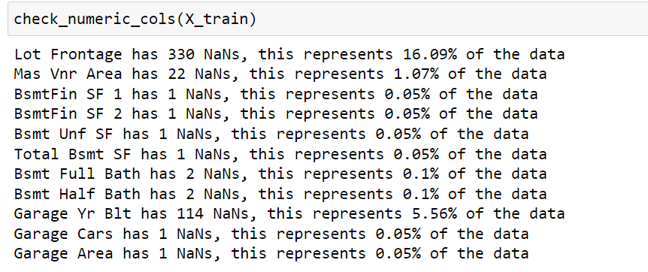
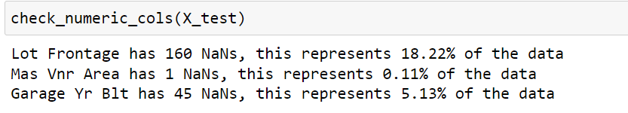
Dealing with Null Values (Numerical Data)
Number of Null values in both the Train and Test dataset
Train Dataset
Test Dataset
For this analysis, we will fill in the numeric features with less than 1.5% of missing data with mean value,
Use linear regression to fill in the NaN values for 'Garage Yr Blt' feature,
And mean value to fill in NaN values for 'Lot Frontage' feature.
Notes:
This slide is to illustrate further on the assumption that we have for the columns to be filled up with the mean value or linear regression method.

Slide 8
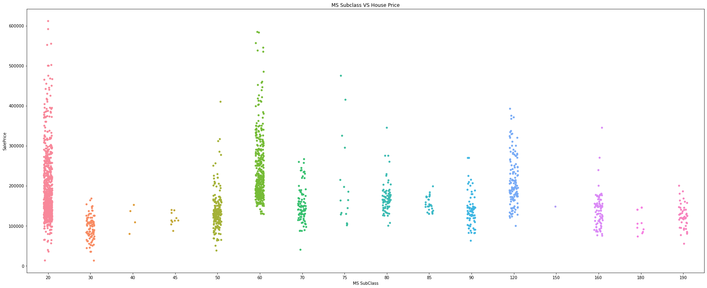
Data Transformation
(Categorical Features)
Nominal Features
We noticed ‘Neighbourhood’ feature may contribute to the overfit during modeling.
To reduce the chance of overfitting, we ranked the feature according to the median price, 3 being Excellent (>75% of the sale price), 2 being Good (50% to 75% of the sale price), 1 being Fair (25% to 50% of the sale price), 0 being Cheap (<25% of the sale price).
Notes:
We move on to categorical features, our findings shows that ‘neighbourhood’ may contribute to overfitting for our predictive model, thus we decide to reduce the overfitting by ranking the mentioned feature according to median price which 3 being 75% or more of the sales price, 2 as 50% to 75% of the sales price, 1 being 25% to 50% and 0 being 25% and below.

Slide 9
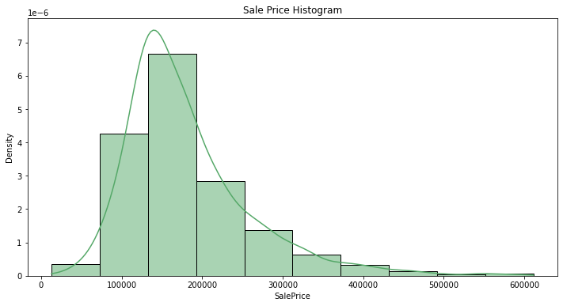
Data Transformation
(Outliers)
The housing price is a right-skewed histogram, indicating that the data contained a lot of outliers with extremely high prices.
Notes:
Next, we plotted a histogram to illustrate the outlier that we potentially have in the dataset and we can see it is very much right skewed which means there are many outlier from 400k onwards

Slide 10
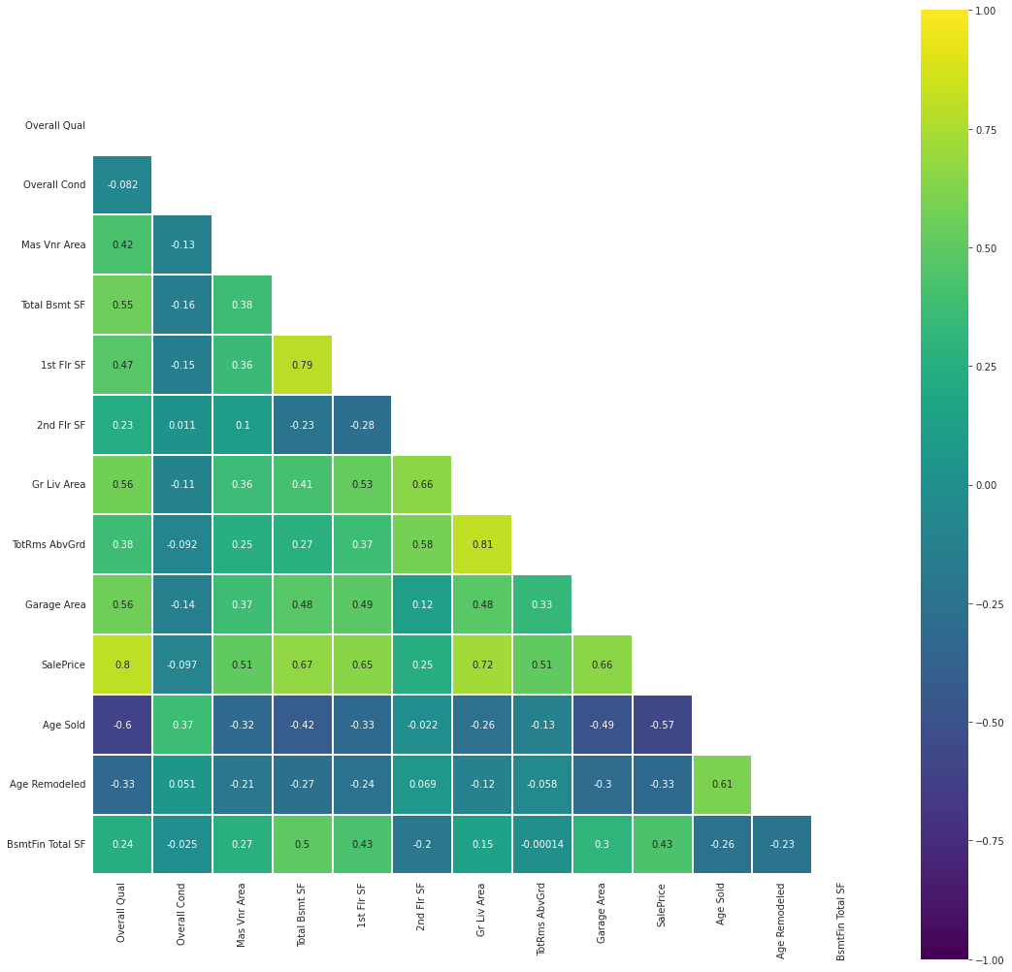
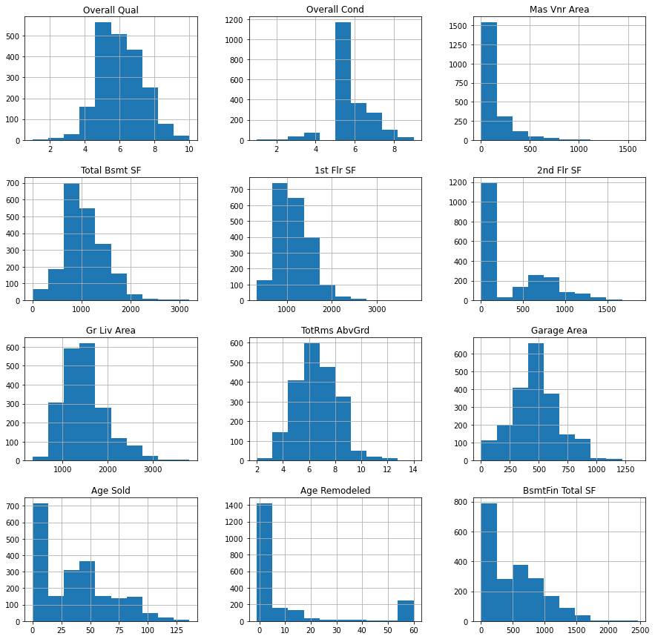
Data Transformation
(Top 5 Variable Correlated to Sale Price)
Notes:
Therefore, to dive deeper and identify which feature contribute the most to the outliers by using the heatmap and histogram.
Thereafter, we will choose the top 3 to perform the removal of the outliers.

Slide 11
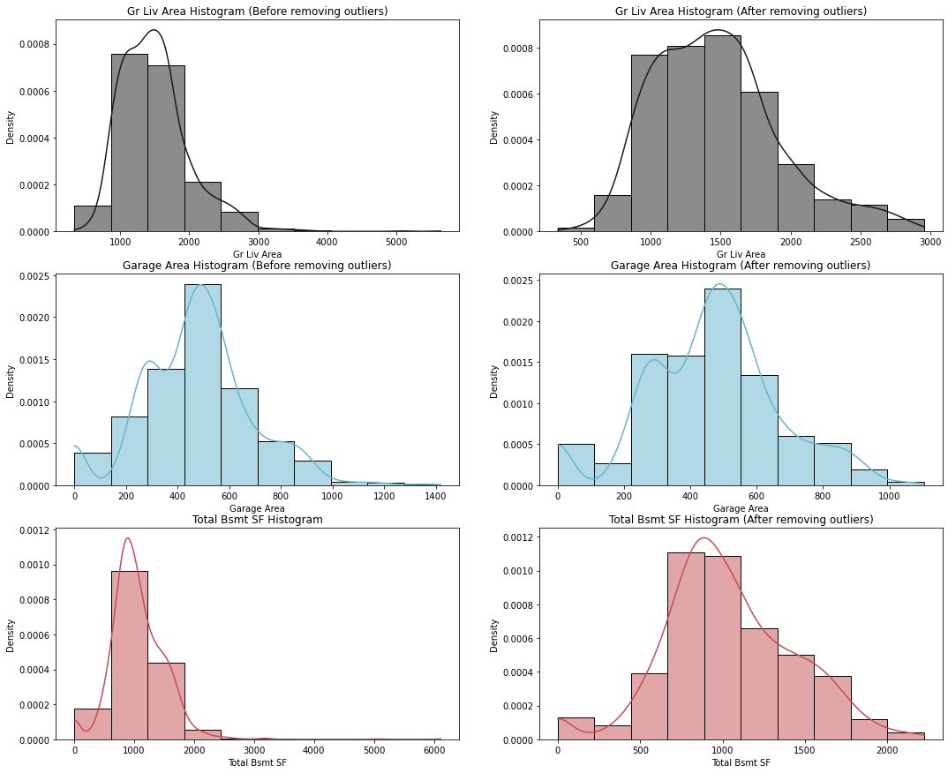
Data Transformation
(Outliers)
Top 3 features that are highly correlated to the sale price. They are ‘Gr Liv Area’, ‘Garage Area’, ‘Total Bsmt SF. All 3 features also follow the pattern of a right-skewed histogram, indicating that the data contained a lot of outliers with extremely high values
After removing the outliers with 3 STD away from the mean values, the histogram of the 3 features definitely appeared more symmetrical, with less extreme values.
Notes:
You can see on the left side, it is the selected top 3 features before dropping the outliers, we can observe that the distribution is not so distributed as compared to the one on the right after dropping the outliers.
Thus, we are on the right track of dropping the outlier since these 3 features are more symmetrical and less extreme values.
I will pass on to jia sheng to explain what is the base model.

Slide 12
BASE MODEL

Slide 13
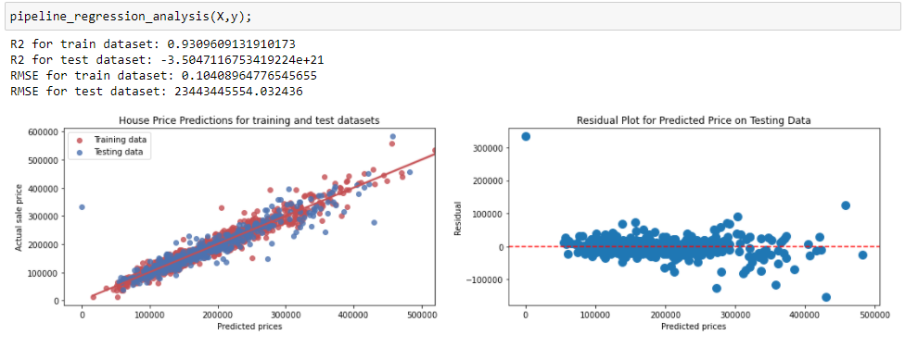
Obviously Extremely Overfitted Base Model
Base Model Perform Worst than Null Model
Notes:
After performing train-test-split on our training dataset, it is obvious our base model is overfitted, with a high R2 and low RMSE for training data, but negative R2 (indicating it perform worse than the null model) and extremely high RMSE for testing data. Variance chart for testing data set also shows very high residuals for all predicted prices.

Slide 14
Feature Engineering
Narrowing Down Independent Variables

Slide 15
Feature Engineering
(Narrowing down independent variables)
Method 1: Feature Selection based on corr() to the sales price
18 features with a minimum threshold of +/- 0.5 correlation score with the sale price
Method 2: Feature Selection based on Lasso regression
50 unique features extracted with minimum threshold coeff of +/- 0.005 score with the dependent variable
Method 3: Hybrid - Identifying Features from Lasso regression & Corr()
56 unique features extracted from the hybrid method
Removing collinear features
For this analysis we dropped 'Garage Cars', 'Garage Yr Blt','1st Flr SF','Exter Qual Rank_3
52 unique features for the final model

Slide 16
Choosing our Final Model
RidgeCV, LassoCV, ElasticNetCV

Slide 17
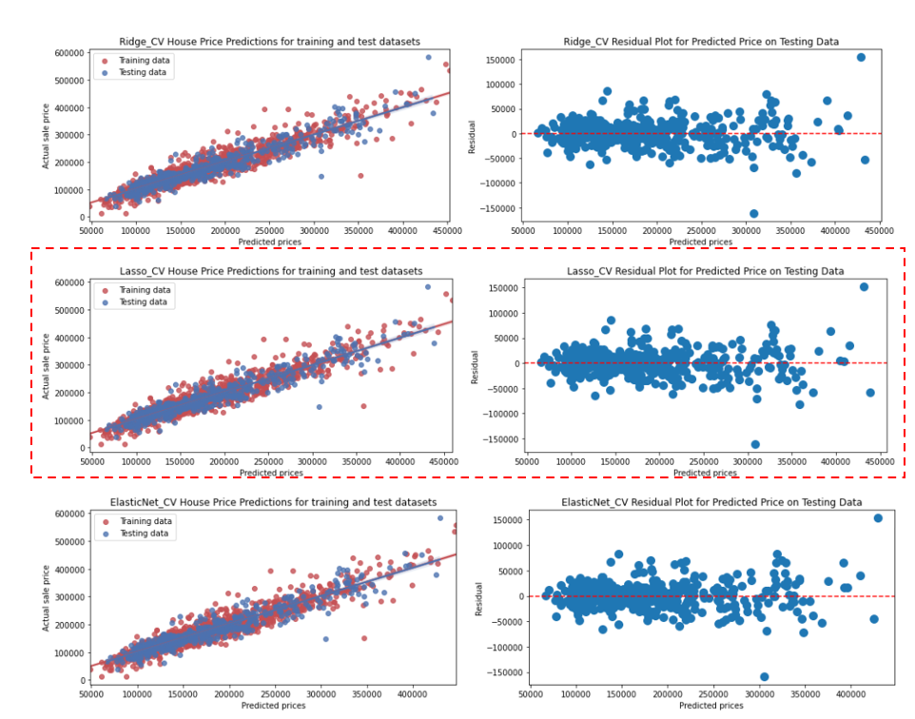
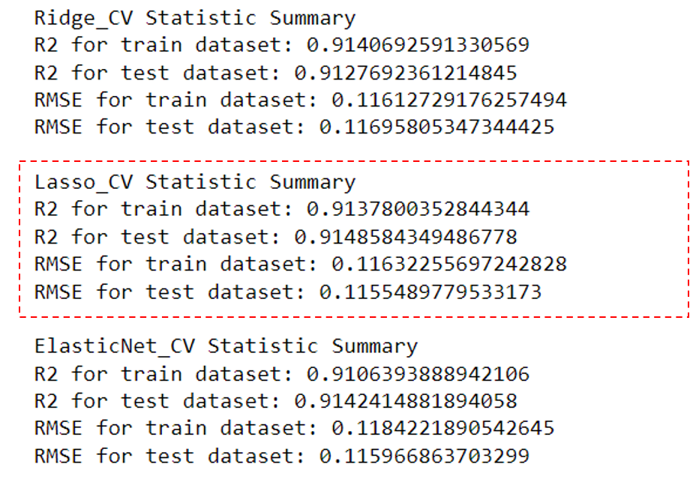
Models Statistical Summary

Slide 18

Conclusion
&
Recommendations
(Significant Findings and Further Improvements)

Slide 19
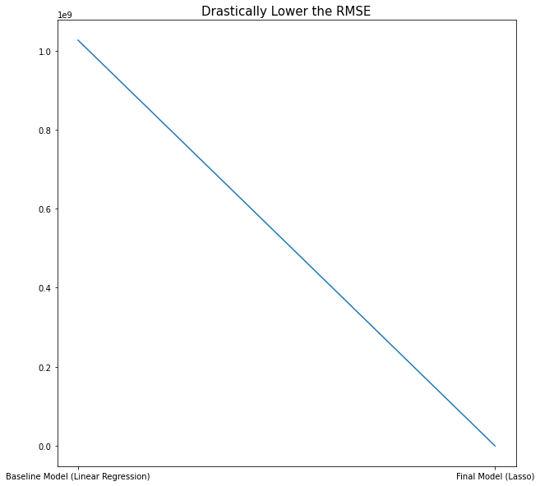
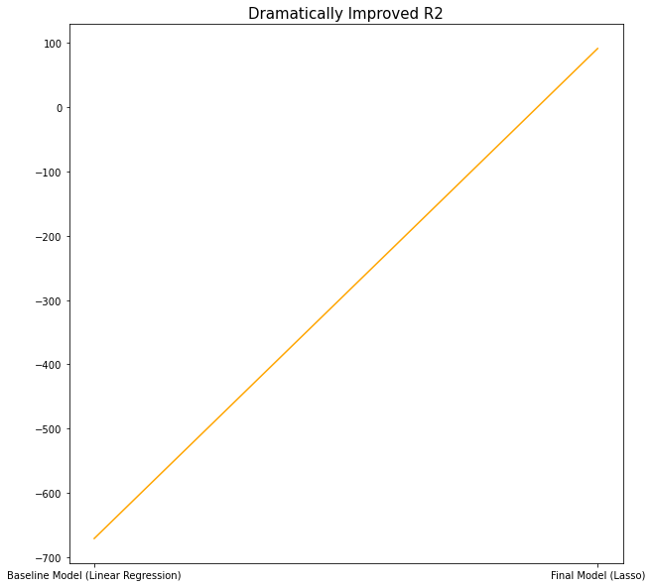
Conclusion
(Significant Findings)
We have successfully been able to develop a lassoCV model for Propnex to predict the housing price in Ames.
23,443,445,554
91.6%
Using our base model as the baseline, we have make significant improvement in terms of metrics (R2 and RMSE) for our testing dataset with regularization and features selections.
0.11
-350%

Slide 20
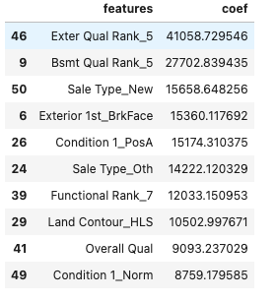
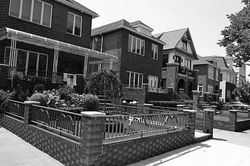
Conclusion
(Significant Findings)
From the lasso coefficient and statistical significant analysis, we observed having an excellent rating for exterior quality adds the most value to the property ($41,058.73). A strong preference for brick common on the exterior covering of the house is also observed, adding $15,360.11 to the house value. Aside from the exterior quality of the house, having an excellent rank for Bsmt Quality helped to add $27,702.84 to the house value

Slide 21
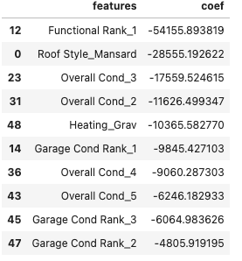
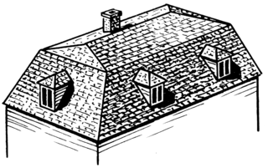
Conclusion
(Significant Findings)
Conversely, having a Mansard Roof Style depreciates a home's value by $28,555.19. Thus, it is best to remove/revamp this feature if it makes financial sense before selling the house.

Slide 22
Recommendations
(Further Improvements for Model)
Use dimension reduction algorithms such as Principal Component Analysis (PCA) to take care of multi collinear features instead.
Utilize other ML methods such as gradient boosting to check for improvement of performance.
Considering reducing the number of columns (original 17) in nominal 'Exterior 1' feature by studying the correlation it has with the house sale and converting them to ordinal feature instead.
Check for outliers among the 52 selected features for the final model.

Slide 23


Thank You!
Presenters:
Ivan Cho
Ng Jia Sheng
Joel Tan
GA Lead Instructor:
Divya
GA Asst. Instructors:
Ben and Shao Quan

